Slide 1
RADIOACTIVITY
Year 9 Science 2025

Slide 2
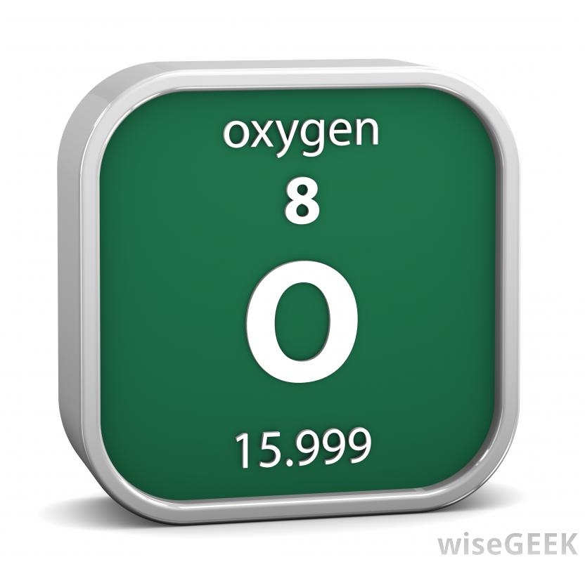
ATOMIC MASS AND NEUTRONS
The Atomic Mass (Mass Number) is the bottom number for every element on the Periodic Table.
By knowing the Atomic Number (top number) and the Atomic Mass (bottom number), the number of neutrons can be calculated.
Atomic Mass = protons + neutrons
Neutrons = Atomic Number - Atomic Mass
8 Protons
8 Electrons
8 Neutrons

Slide 3
REPRESENTING ATOMS
Atomic mass or Mass number (number of protons + number of neutrons)
Element symbol
A
For example
x
12
Z
Atomic number (number of protons)
C
6

Slide 4


Slide 5
ISOTOPES
An element’s identity is based on the number of protons in its nucleus.
An isotope is an element with a different number of neutrons.
carbon-12 and carbon-14 are isotopes of carbon.
12
14
Carbon has six protons.
This carbon has two more neutrons increasing its mass from 12 to 14.
6
C
6
C

Slide 6
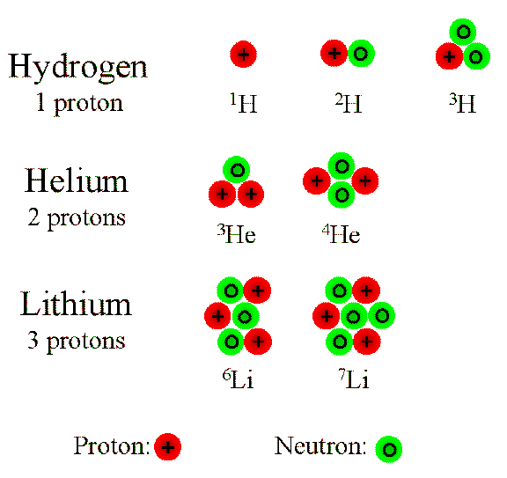
EXAMPLES OF ISOTOPES

Slide 7
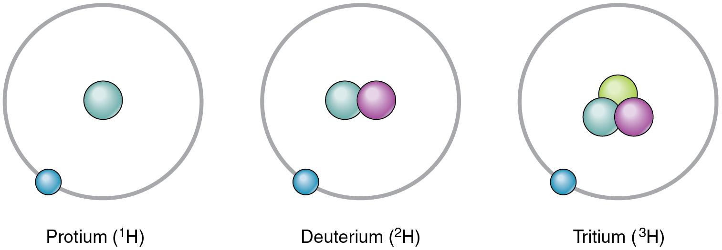
ISOTOPE STABILITY
All elements have more than one isotope.
A stable isotope is one in which the nucleus is unlikely to break apart.
An unstable isotope is one in which the nucleus is likely to break apart.
Isotopes of Hydrogen
Protium – stable
Deuterium - stable
Tritium - unstable

Slide 8
ISOTOPE STABILITY
The ‘nuclear forces’ hold the nucleus together.
Neutrons help hold the protons the right distance apart from each other to maintain nuclear stability.
Some isotopes are unstable because:
  Too many neutrons for the number of protons
  Too many protons for the number of neutrons
  Too many protons and neutrons (the nucleus is too heavy).

Slide 9
RADIOACTIVE DECAY
Isotopes break down (decay) when they are unstable.
When they break down they emit particles or electromagnetic radiation from their nucleus (called radiation).
This turns them into a different stable element

Slide 10
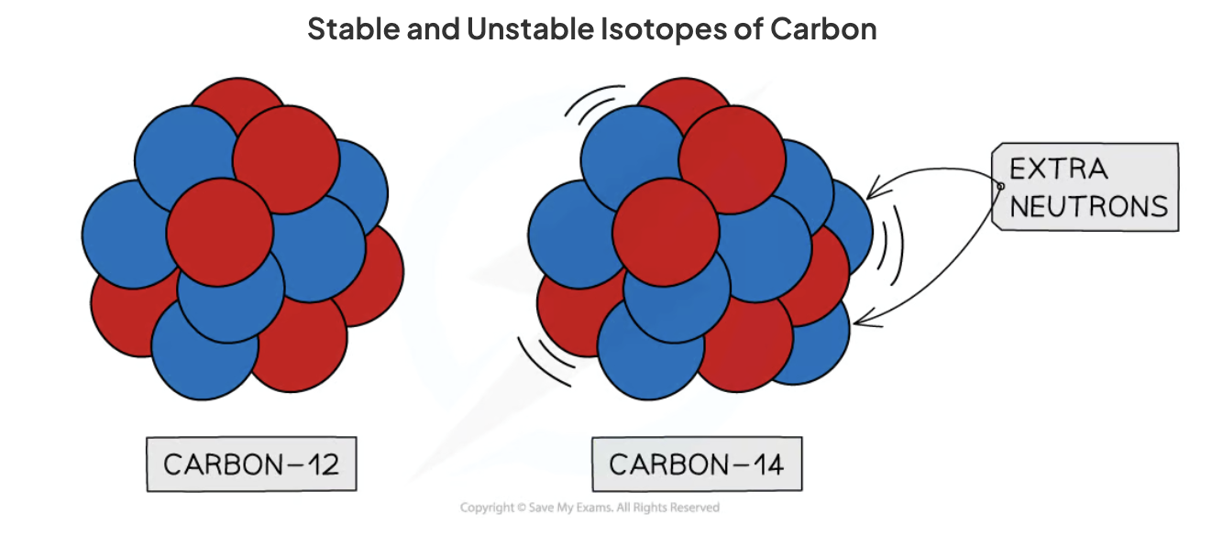
EXAMPLE – CARBON
Carbon-12 is stable; it has 6 protons and 6 neutrons.
Carbon-14 is unstable; it has 6 protons and 8 neutrons.

Slide 11


Slide 12
TYPES OF RADIATION
Three types:
  Alpha particles α
  Beta particles β
  Gamma radiation γ
  α
A
X
Z
Unstable
  γ
  β

Slide 13

ALPHA DECAY
Two protons and two neutrons are lost from a nucleus when it emits an alpha particle. This means that:
  The atomic mass number decreases by 4
  The atomic number decreases by 2
A new element is formed that is two places lower in the Periodic Table than the original element.

Slide 14

BETA DECAY
In beta decay, a neutron changes into a proton plus an electron. The proton stays in the nucleus. The electron leaves the atom with high energy as a beta particle.
The nucleus has one more proton and one less neutron. This means that:
  The atomic mass number stays the same
  The atomic number increases by 1

Slide 15

GAMMA RADIATION
An unstable isotope kicks out a photon and releases some of its energy
The atom’s nucleus stays the same, it just loses energy

Slide 16
PENETRATING POWER OF RADIATION
α
β
γ
Thin mica
Skin or paper
stops ALPHA
Thin aluminium
stops BETA
Thick lead
reduces GAMMA
https://www.youtube.com/watch?v=TJgc28csgV0

Slide 17
IONISING POWER OF RADIATION
The level of damage done by the type of radiation and where the radiation source is situated.
If inside the body:
Alpha has the highest ionising power therefore it can do the most damage
Beta is less and gamma radiation is the least ionising.
If outside the body:
Gamma radiation is the most dangerous as alpha can be stopped with skin.

Slide 18
MATCH THE RADIATION
Electromagnetic radiation
Stopped by paper or skin
Alpha
High energy electron
Reduced by lead
Beta
Helium nuclei
Stopped by aluminium
Gamma

Slide 19
Half-Lives

Slide 20
WHITEBOARD STARTER
A farmer has a warehouse of two million corn cobs in it.
Everyday he sells exactly half of his remaining stock.
How long before he has sold every last kernel of corn?

Slide 21
HALF-LIFE
2 definitions:
The time it takes the number of radioactive nuclei in a sample to decrease by 50%.
The time it takes the count rate from a radioisotope to decrease by 50%.

Slide 22
GRAPHICAL REPRESENTATION OF HALF LIFE
Decay rate (counts/min)
What is the half life of the radioisotope represented by the following graph?
80
60
40
20
The time it takes the count rate to decrease from 80 per min to 40 per min is what?
Double check, the time it takes the count rate to decrease from 40 per min to 20 per min is?
2 4 6 8
Time (min)
The half life of the radioisotope is 2 mins.

Slide 23
HALF-LIFE PRACTICAL
Practical

Slide 24
RADIOCARBON DATING
All living things (trees, plants, humans, animals etc) absorb radioactive carbon-14 and carbon-12 into their tissue.
When living things die, they stop taking in carbon. The carbon-14 present at death slowly decays to carbon-12 (half-life is ~5600 years) and other atoms.
The radioactivity of items due to the decay of carbon-14 can be used to date bones, wood, paper and cloth by measuring the remaining carbon-14 atoms.

Slide 25

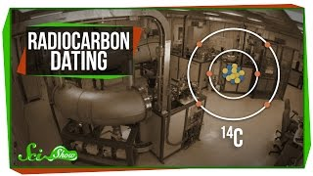

Slide 26
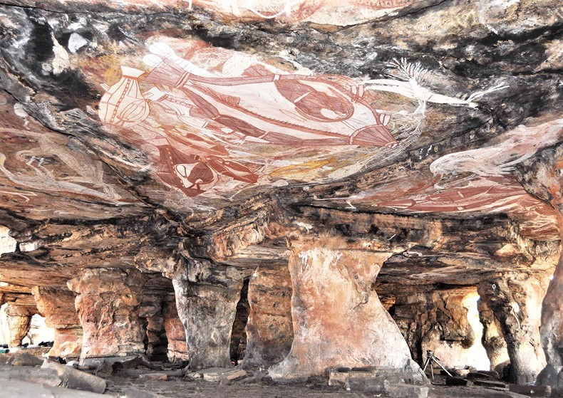
Indigenous Perspective - Radiocarbon Dating
Radiocarbon (¹⁴C) dating measures the decay of carbon-14 in once-living material. Since ¹⁴C has a half-life of ~5,730 years, it is useful for dating organic remains up to about 50,000 years old .
Archaeologists have used radiocarbon dating on charcoal from ancient hearths, shell middens, bone, and plant remains to establish human presence. For example:
Sites such as Lake Mungo (New South Wales) have yielded charcoal and bone dated to ~40,000–50,000 years ago, among the earliest evidence of humans outside Africa.
Northern Australian sites (e.g. Arnhem Land rock shelters) show radiocarbon dates consistent with continuous occupation for tens of thousands of years.

